Slide 1
An introduction to RL and deep RL
Babak Badnava
Multi-agent systems lab, IUST

Slide 2
Different type of machine learning
Supervised
Labeled data
Unsupervised
Unlabeled data
Semi-supervised
A small amount of labelled data with a large amount of unlabelled data
Reinforcement learning
Data have no label, but there is a feedback.

Slide 3
Reinforcement learning
Agent-oriented learning
Learning by interacting with an environment to achieve a goal
Learning by trial and error, with only delayed evaluative feedback (reward)
The kind of machine learning most like natural learning
Learning that can tell for itself when it is right or wrong

Slide 4
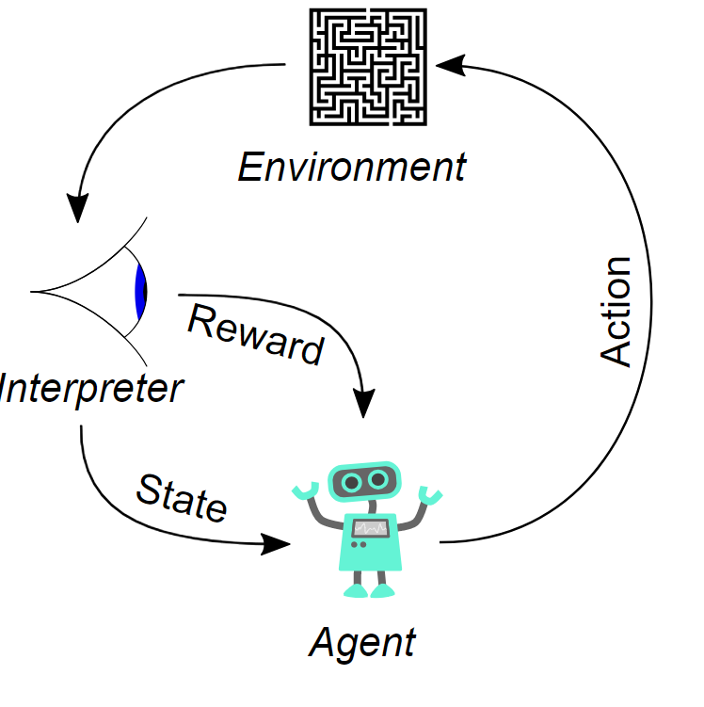
Reinforcement learning (2)
An agent observes the environment
Makes a decision
And gets a feedback
Image taken from Wikipedia.org

Slide 5
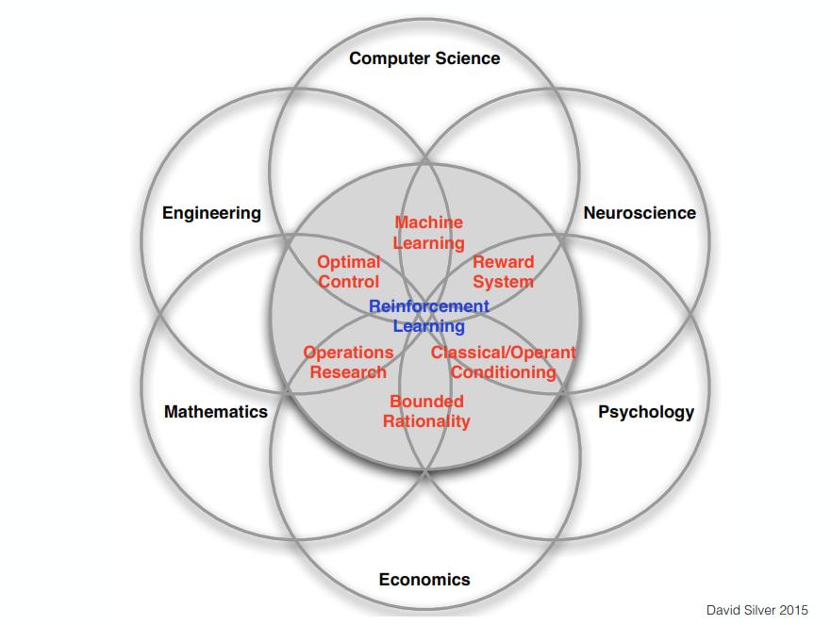
Where it came from?

Slide 6
Applications
Robotics
Personalized web services
Neuroscience
Autonomous cars
…

Slide 7
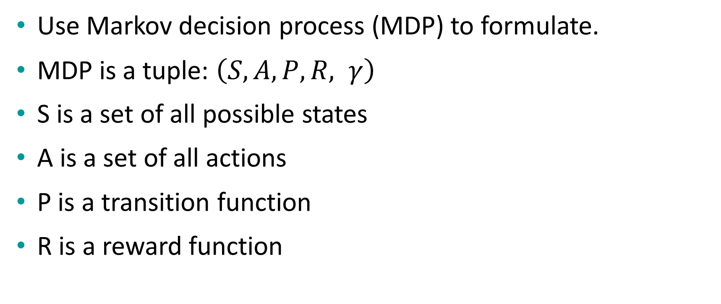
How to formulate?
Use Markov decision process (MDP) to formulate.
MDP is a tuple: $\left(S, A, P, R, γ\right)$
S is a set of all possible states
A is a set of all actions
P is a transition function
R is a reward function

Slide 8
Example: autonomous vehicle
States: a set of all possible value for all sensors, speed, amount of available gas, …
Actions: Pedals, Steering Wheels, …
Reward: amount of money for an autonomous cab, distance to the destination, …..
Transition function: natural rules + human-made rules
Gravity
Driving rules
…

Slide 9
Practice
Formulate an MDP for an online shopping website who wants to increase its profit by giving its customers a discount.
Formulate an MDP for a classification task like MNIST
Formulate an MDP for a manufacturing robot

Slide 10
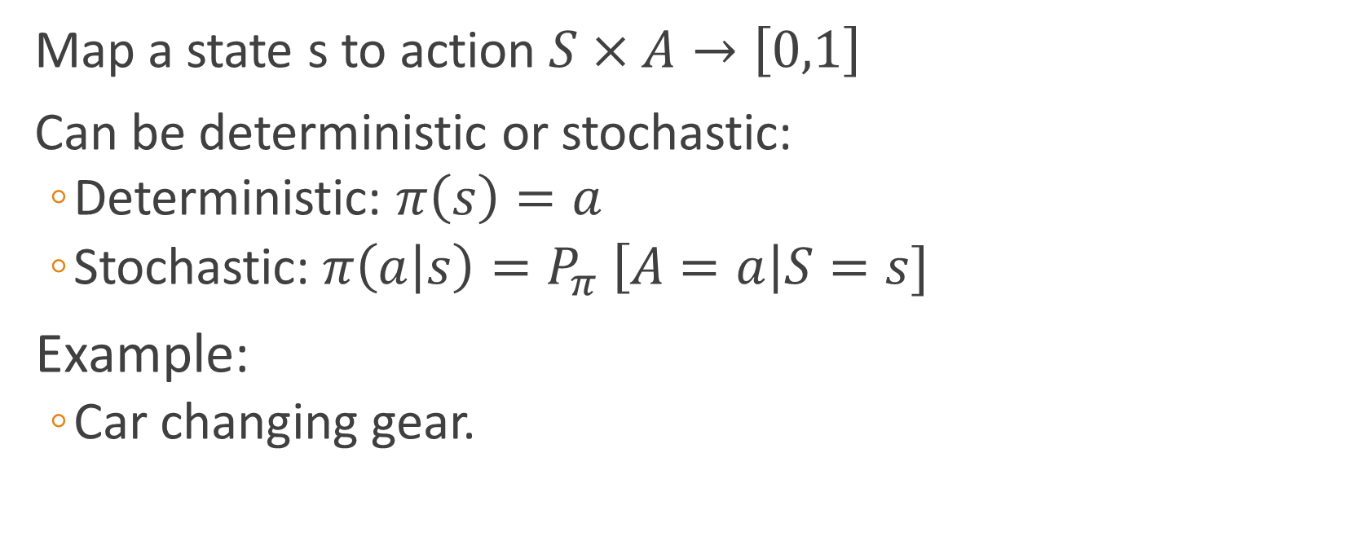
Policy function
Map a state s to action $S×A→\left[0,1\right]$
Can be deterministic or stochastic:
Deterministic: $π\left(s\right)=a$
Stochastic:$π\left(a | s\right)=P_{π} \left[A=a\right|S=s]$
Example:
Car changing gear.

Slide 11
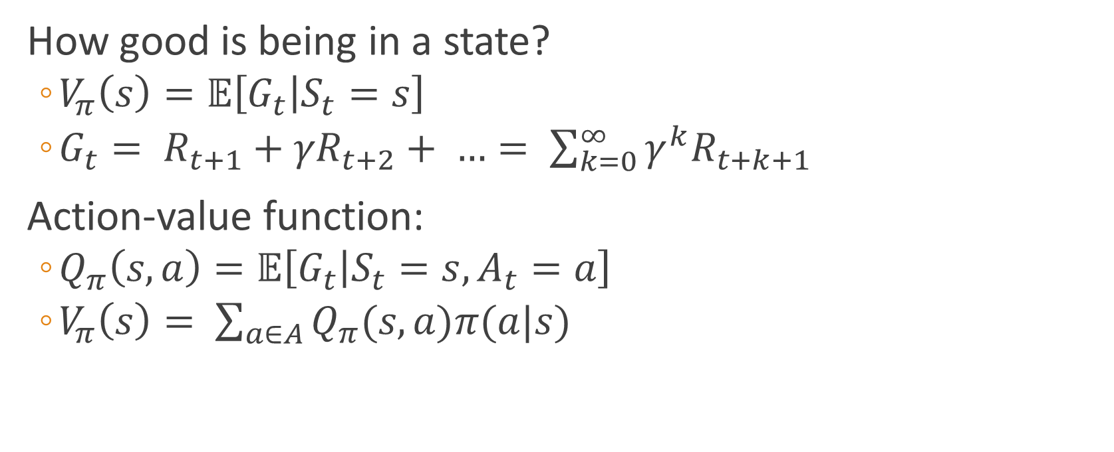
Value function
How good is being in a state?
$V_{π}\left(s\right)=𝔼\left[G_{t} | S_{t}=s\right]$
$G_{t}= R_{t+1}+{γR}_{t+2}+ …= \sum_{k=0}^{∞}{γ^{k}R_{t+k+1}}$
Action-value function:
$Q_{π}\left(s,a\right)=𝔼\left[G_{t} | S_{t}=s, A_{t}=a\right]$
$V_{π}\left(s\right)= \sum_{a∈A}{Q_{π}(s,a)π(a|s)}$

Slide 12
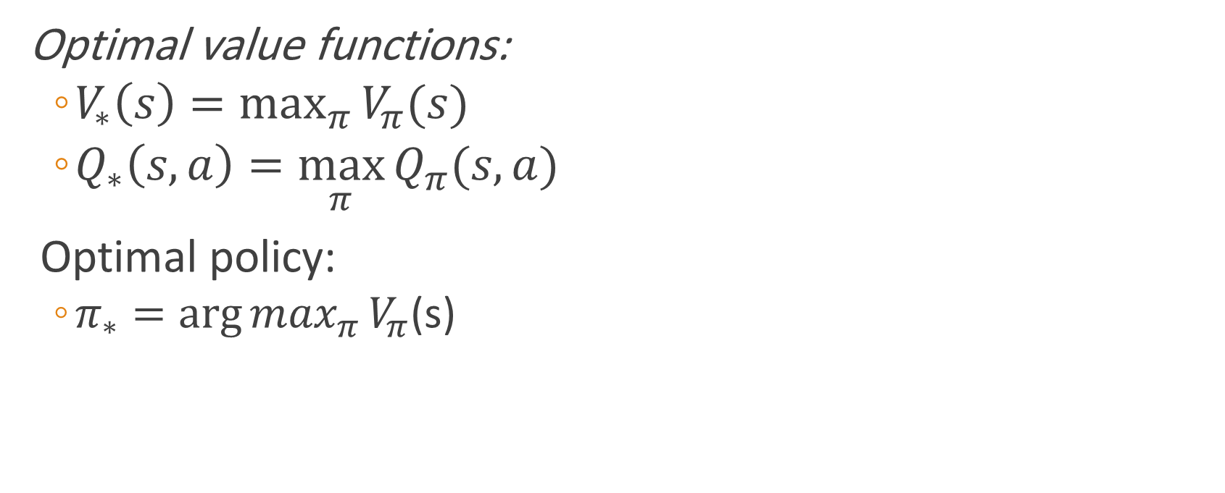
Optimal value and policy
Optimal value functions:
$V_{∗}\left(s\right)=\max_{π}{V_{π}(s)}$
$Q_{∗}\left(s, a\right)=\max_{π}{Q_{π}(s,a)}$
Optimal policy:
$π_{∗}=\arg{\max_{π}{V_{π}}}$(s)

Slide 13
Different type of MDP and how to solve them?
Model-based:
We know both the transition function and reward function.
Dynamic programming.
Model-free:
No transition function.
No reward function.

Slide 14
Model-free
Value estimation
Estimate the value function
Use a predefined soft policy function
Epsilon greedy
Boltzmann policy
Policy approximation
Directly approximate the optimal policy function

Slide 15
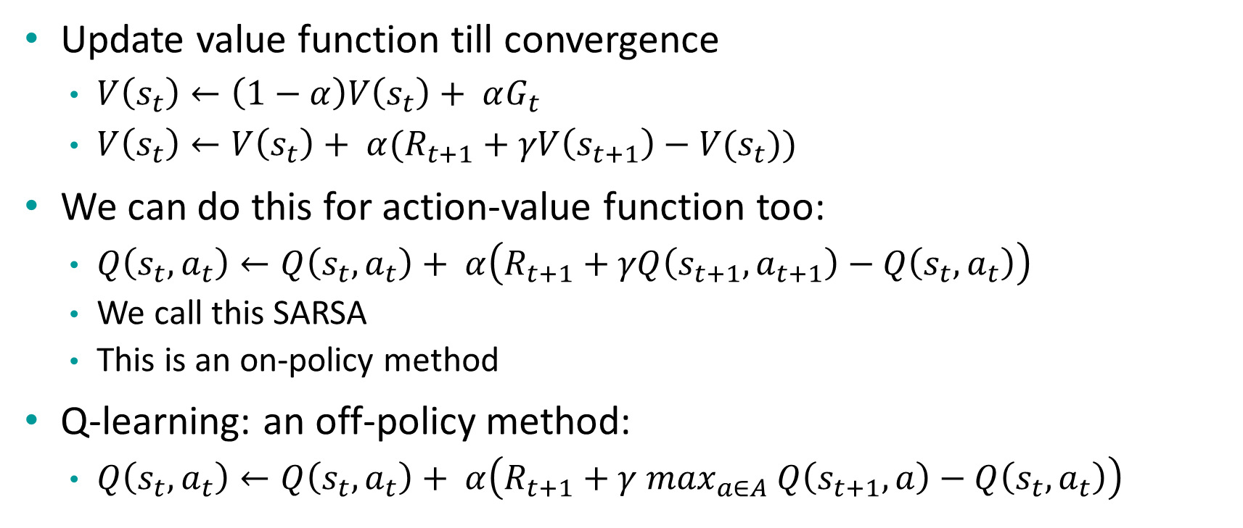
Value estimation
Update value function till convergence
$V\left(s_{t}\right)←\left(1−α\right)V\left(s_{t}\right)+ αG_{t}$
$V\left(s_{t}\right)←V\left(s_{t}\right)+ α(R_{t+1}+γV\left(s_{t+1}\right)−V(s_{t}))$
We can do this for action-value function too:
$Q\left(s_{t},a_{t}\right)←Q\left(s_{t},a_{t}\right)+ α\left(R_{t+1}+γQ\left(s_{t+1}, a_{t+1}\right)−Q\left(s_{t}, a_{t}\right)\right)$
We call this SARSA
This is an on-policy method
Q-learning: an off-policy method:
$Q\left(s_{t},a_{t}\right)←Q\left(s_{t},a_{t}\right)+ α\left(R_{t+1}+γ \max_{a∈A} Q\left(s_{t+1}, a\right)−Q\left(s_{t}, a_{t}\right)\right)$

Slide 16
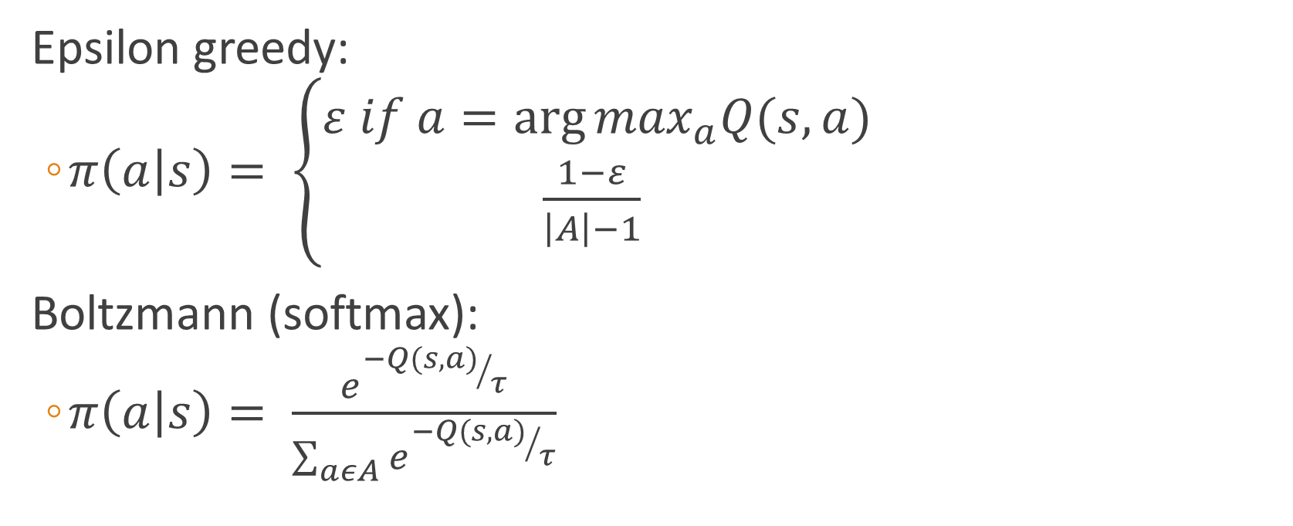
Soft policies
Epsilon greedy:
$π\left(a | s\right)= \left\{\begin{aligned}ε if a=\arg{\max_{a}Q(s, a)} \\ \frac{1−ε}{\left|A\right|−1} \end{aligned}\right.$
Boltzmann (softmax):
$π\left(a | s\right)= \frac{e^{{−Q(s,a)}/τ}}{\sum_{aεA}{e^{{−Q(s,a)}/τ}}}$

Slide 17
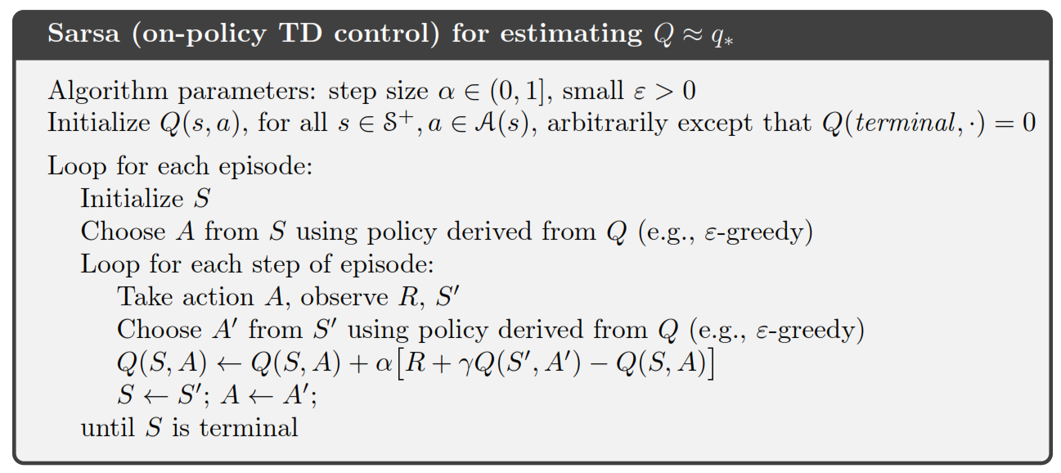
Let’s put it all together: SARSA
Algorithm from Sutton 2018

Slide 18
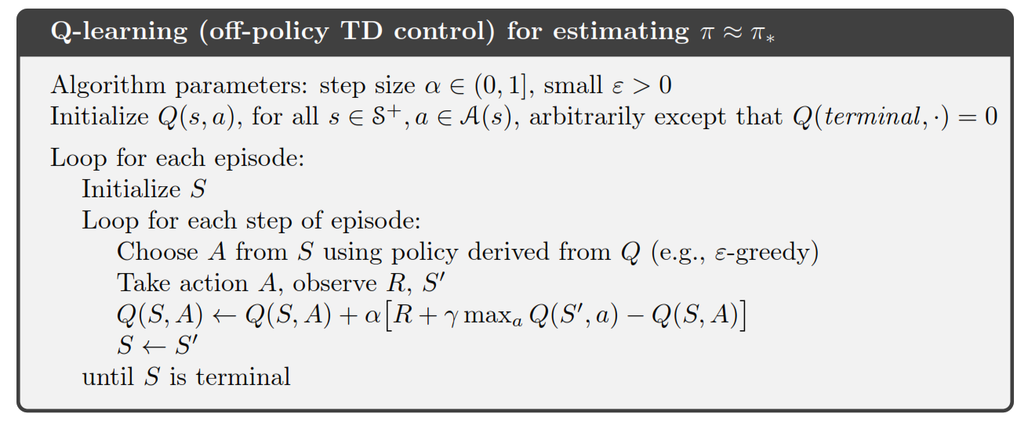
Let’s put it all together: Q-learning
Algorithm from Sutton 2018

Slide 19
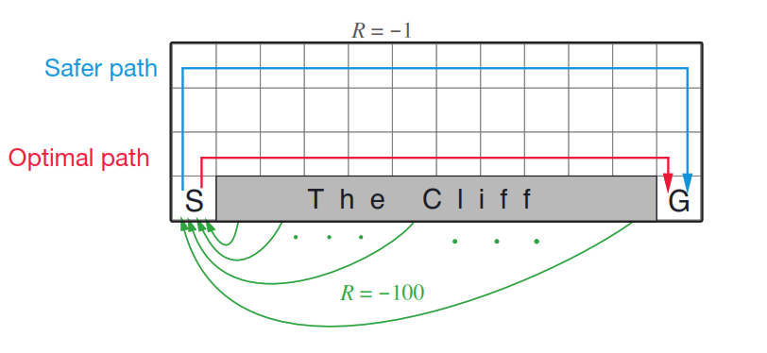
A sample python code
Sutton 2018

Slide 20
Practice
Try to implement SARSA and Q-learning for a continuous environment like Mountain Car.

Slide 21
References
An introduction to Reinforcement Learning by Sutton 2nd edition

